Slide 1
NLP Flashcard

Slide 2
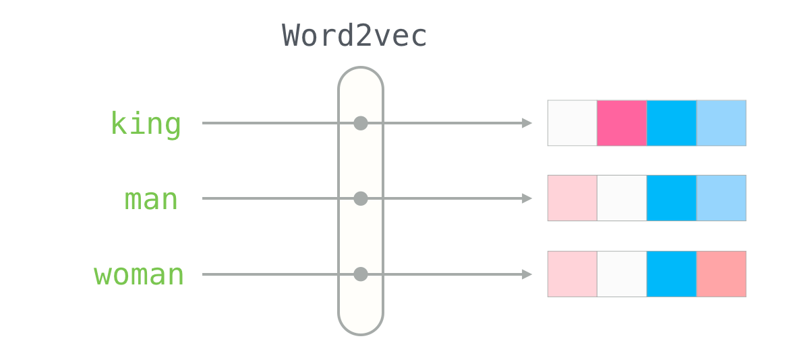
Word2Vec
Word2Vec is a neural network-based algorithm for learning word embeddings, transforming words into dense vector representations that capture semantic and syntactic relationships
A shallow, two-layer neural network that predicts word relationships based on surrounding words in a given context

Slide 3
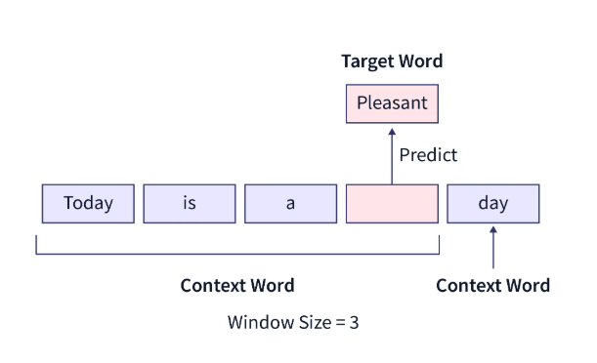
Continuous Bag-of-Words (CBOW)
CBOW is based on predicting a target word given the context of the surrounding words
It is trained using a feedforward neural network where the input is a set of context words, and the output is the target word.
The model learns to adjust the weights of the neurons in the hidden layer to produce an output that is most likely to be the target word

Slide 4
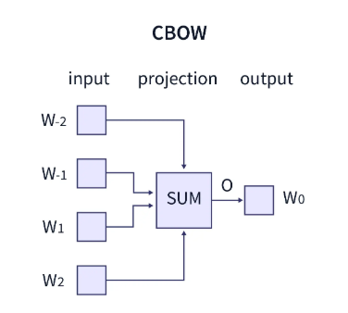
Continuous Bag-of-Words (CBOW)
Goal is to learn a dense representation of words, where semantically similar words are close to each other in the embedding space
The model transforms this sentence into word pairs (context word and target word). The user must configure the window size

Slide 5
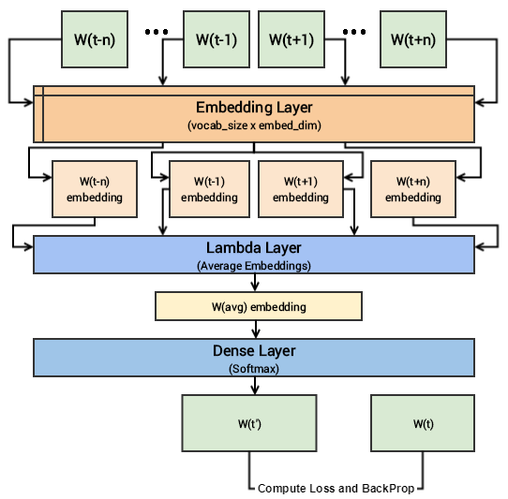
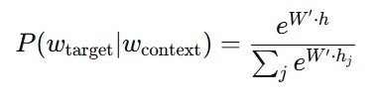
Continuous Bag-of-Words (CBOW)
Random weight initialization
Embedding lookup (E)
Embeddings of context words are average to form a single hidden layer representation (h)
Hidden layer is multiplied by a weight matrix through softmax function to obtain prediction
Backpropagate to update weight matrix (W) and embedding matrix (E)

Slide 6
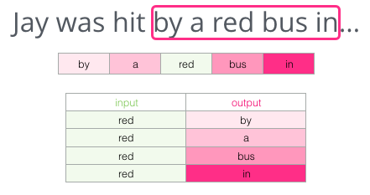
Skip-gram
Skipgram is based on predicting context words given a target word.
It is trained using a feedforward neural network, where the input is a single word, and the output consists of multiple context words.
The model learns to adjust the weights of the neurons in the hidden layer to produce outputs that are most likely to be the context words.

Slide 7
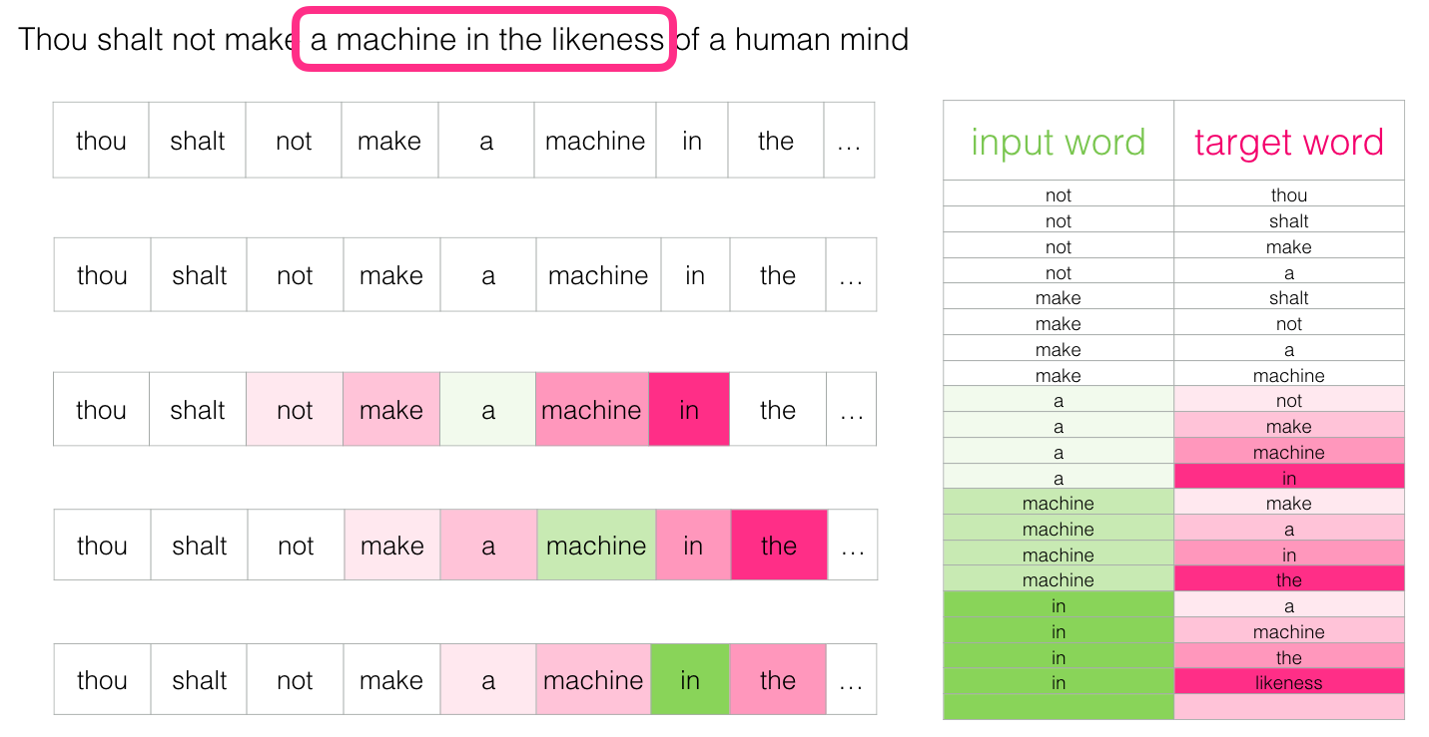
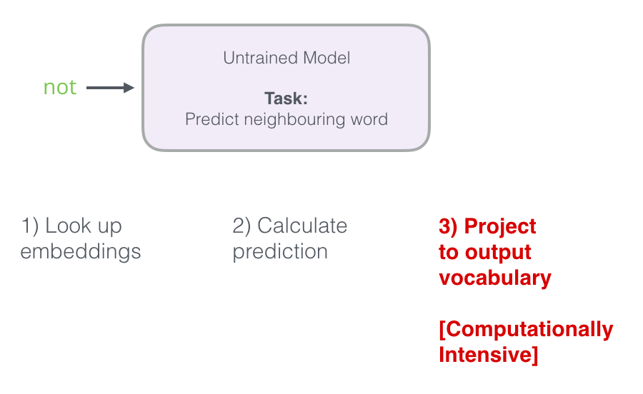
Skip-gram
Goal is to learn a dense representation of words, where semantically similar words are close to each other in the embedding space
The model transforms a sentence into word pairs (target word and context words).
The user must configure the window size, which determines how many nearby words are considered

Slide 8
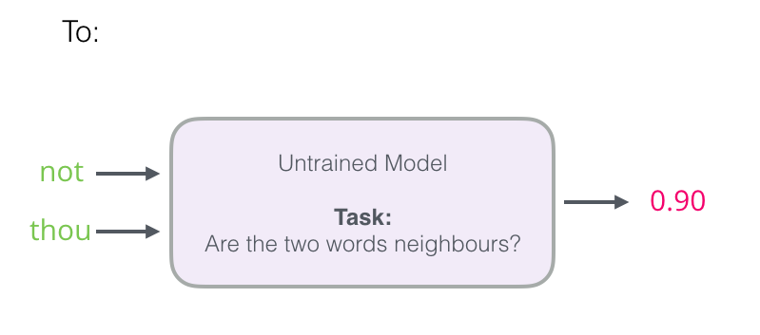
Skip-gram
Switch it to a model that takes the input and output word, and outputs a score indicating if they’re neighbors or not (0 for “not neighbors”, 1 for “neighbors”)

Slide 9
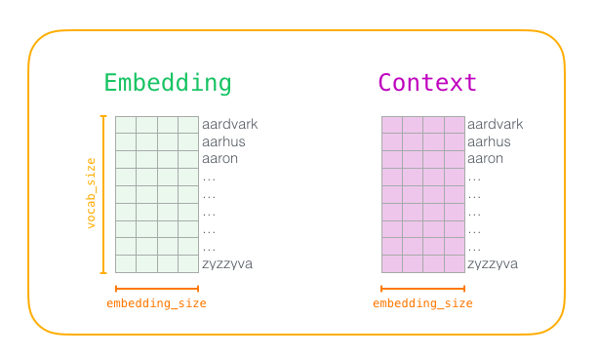
Skip-gram
Initialize Embedding and Context matrix to random values
Lookup Embedding and Context matrix for input and output words
Sigmoid of dot product
Compute loss and backpropagate to update model parameters

Slide 10
Negative sampling
In the Skip-Gram model, our goal is to learn word embeddings by predicting context words given a target word.
This involves calculating probabilities using the softmax function, which requires computing similarities between the target word and all words in the vocabulary.
For large vocabularies, this becomes computationally expensive.
Negative sampling is an optimization technique introduced in Word2Vec to make training feasible by simplifying the softmax computation.
Instead of updating weights for the entire vocabulary, we update weights for only a small subset of words.
This significantly reduces computation.

Slide 11
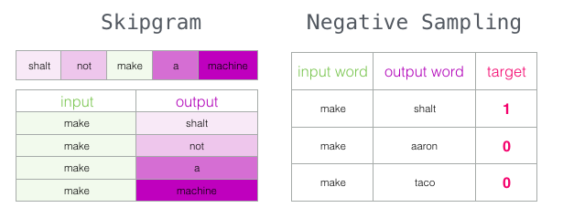
Negative sampling
For a given target word, we take actual context words. These are positive samples
Instead of computing softmax over the entire vocabulary, we randomly sample a few words and treat them as negative example
The model’s goal is now to maximize the probability of positive samples and minimize the probability of negative samples

Slide 12
Impact of window size
Larger window sizes require more computation because more word pairs are generated, increasing the training time.
Smaller window sizes train faster but may not capture deeper semantic connections
Large window sizes for broader semantic relationships
Small window sizes for syntactic (local word dependencies)

Slide 13
Limitations of Word2Vec
Each word is mapped to single fixed vector regardless of its context. This means a word like “Apple” will have a single representation.
Uses a window-based co-occurrence approach. So, it does not capture word order.
Since, its trained with fixed window sizes, it does not capture long range dependencies
New word representations are not handled properly

Slide 14
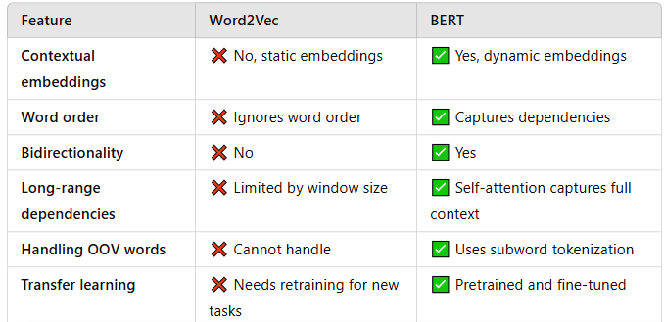
Word2Vec vs BERT

Slide 16
Word2Vec
What is Word2Vec, and why do we use it in NLP?
What is the difference between CBOW and Skip-Gram models?
Why does Word2Vec learn dense vector representations instead of using one-hot encoding?
What is the role of the embedding matrix in Word2Vec?
What does it mean when two words have similar embeddings?
How does CBOW predict a target word?
How does Skip-Gram predict context words?
Why does Skip-Gram perform better than CBOW on smaller datasets?
What are the advantages and disadvantages of CBOW vs. Skip-Gram?
What is negative sampling, and why is it used in Skip-Gram?
Explain hierarchical softmax and how it speeds up training.
What is the impact of window size in Word2Vec models?
Why do we normalize word embeddings?
How are word embeddings stored and used after training

Slide 17
Why is Word2Vec unsupervised learning?
What is the mathematical formulation of negative sampling?
Explain the objective function for Word2Vec.
How does backpropagation update word embeddings in CBOW and Skip-Gram?
How can you use pre-trained Word2Vec embeddings for a new NLP task?
Why do we use cosine similarity to compare word embeddings instead of Euclidean distance?
What are the limitations of Word2Vec? How does BERT improve upon it?
How would you fine-tune Word2Vec on a domain-specific corpus?
How does Word2Vec handle polysemy (words with multiple meanings)?
How does subword information (e.g., FastText) improve upon Word2Vec?
Can Word2Vec capture word order information? Why or why not

Slide 18
Implement CBOW using NumPy and Python.
Implement Skip-Gram with Negative Sampling using TensorFlow or PyTorch.
Write a function to find the most similar words using Word2Vec embeddings.
Given a sentence, use Word2Vec to find synonyms for each word.
Use pre-trained Word2Vec embeddings (e.g., Google News) to compute similarity between two sentences.

Slide 19
I appreciate the opportunity to discuss the compensation aspect. Currently, my total compensation is 32.5 LPA, which includes 25L fixed, a 5L performance bonus, and 2.5L in stock grants per year. Given my experience, expertise, and market benchmarks, my expected total compensation is in the range of 55 to 60 LPA.
I understand this might seem like a significant increase, but I’d like to highlight that I have a major deliverable coming up at my current company. Post this, I am expecting a salary revision that will likely bring my fixed component to 30L, which also increases my bonus potential, taking my total compensation to 38.5 LPA. Additionally, I am on track to transition into a Squad Lead role over the next two years, which positions me for further growth. Given this, I’d ideally like to be in the 55–60 LPA range, as it aligns with my experience and market standards. Would there be flexibility in bridging this gap?
Given my contributions, leadership trajectory, and the market standards for this role, I believe 55–60 LPA is a fair expectation. I am excited about the opportunity at Millennium and am keen to contribute at a high level. I’d love to hear your thoughts on how we can align on this.

Slide 20
I was really excited about this role, but I was expecting a package that reflects both my experience and the market value for similar roles. Do you think there’s any flexibility in structuring the offer differently, perhaps with a higher fixed component or additional stock grants? If I move, I want to ensure financial stability without depending too much on variable pay.
Before we dive into specific numbers, could you share the budget range for this role? I’d love to understand how my expectations align with your compensation structure
I’d love to explore how we can structure this to maximize both the fixed and variable components. Is there room for flexibility to bring the offer closer to my expectation? I really see this as a long-term move and am excited about the role. If we can finalize at 50L fixed, I’m ready to proceed today

Slide 21
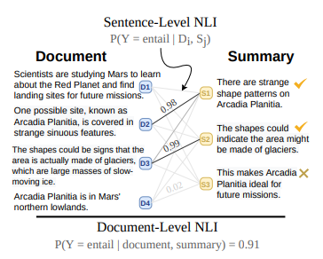
Summac
https://arxiv.org/pdf/2111.09525
Summac (Summarization Consistency) is an evaluation metric designed to measure how well a generated summary preserves the key facts and meaning of the original text.
Summac primarily focuses on factual consistency rather than just word overlap, which is a limitation of traditional metrics like ROUGE.
It uses semantic similarity and natural language inference (NLI) techniques to determine whether the generated summary maintains the factual claims made in the original document

Slide 22
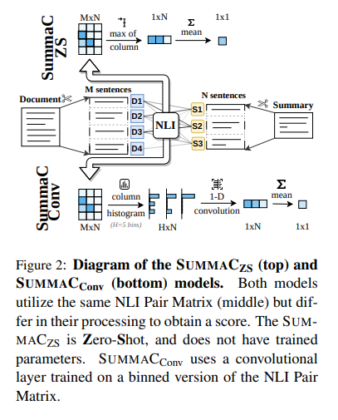
Summac
We generate an NLI Pair Matrix by splitting a (document, summary) pair into sentence blocks.
Document is split into M blocks
Summary is split into N blocks
Each pair is run through a NLI model which produces probability distribution over entailment, contradiction and neutral
Reduce the M*N into one dimensional N shape by taking max of each column.

Slide 23
Summac
Convert each pair into fixes size histogram containing distribution of scores
The binned matrix is then passed through a 1-D convolution layer with a kernel size of H.
The convolution layer scans the summary histograms one at a time, and compiles each into a scalar value for each summary.
Finally, the scores of each summary sentence are averaged to obtain the final summary-level score

Slide 24
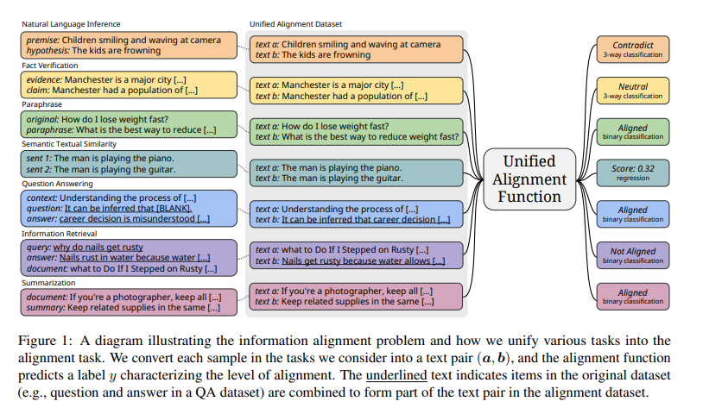
AlignScore
https://arxiv.org/pdf/2305.16739
AlignScore is an evaluation metric that measures how well a generated response aligns with a given reference text or instruction.
It’s particularly useful in evaluating summarization, paraphrasing, and instruction-following tasks, where we want to ensure that the AI-generated output stays true to the intended meaning and context

Slide 25
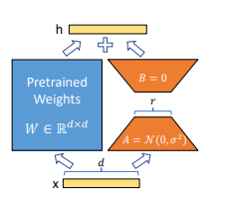
Low Rank Adaptation
https://arxiv.org/pdf/2106.09685
LoRA (Low-Rank Adaptation) is a technique designed to efficiently fine-tune large language models (LLMs) while significantly reducing computational and memory costs.
The key idea behind LoRA is that instead of updating all the parameters of a pre-trained model, we introduce small, trainable low-rank matrices into specific layers.
This drastically reduces the number of trainable parameters while still allowing the model to adapt to new tasks

Slide 26
Low Rank Adaptation
The core idea behind LoRA is that neural networks have an intrinsic low-rank structure—meaning that most of the information needed for adaptation can be captured using fewer parameters.
Instead of updating a weight matrix W in a model, LoRA represents the updates as the product of two much smaller matrices, A and B
The rank of a matrix refers to the number of linearly independent rows or columns in the matrix

Slide 27
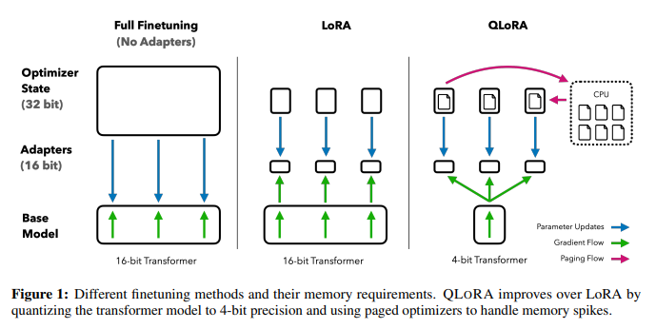
QLORA
QLoRA (Quantized Low-Rank Adaptation) is a technique designed to fine-tune large language models (LLMs) efficiently while significantly reducing the memory footprint.
It allows us to take advantage of quantized models, which use reduced precision (e.g., 4-bit instead of 16-bit or 32-bit) to lower memory usage, and then apply Low-Rank Adaptation (LoRA) to fine-tune only a small set of additional parameters
Double quantization
Paged optimizer

Slide 28
LoMo
https://arxiv.org/pdf/2306.09782
AlignScore is an evaluation metric that measures how well a generated response aligns with a given reference text or instruction.
It’s particularly useful in evaluating summarization, paraphrasing, and instruction-following tasks, where we want to ensure that the AI-generated output stays true to the intended meaning and context

Slide 29
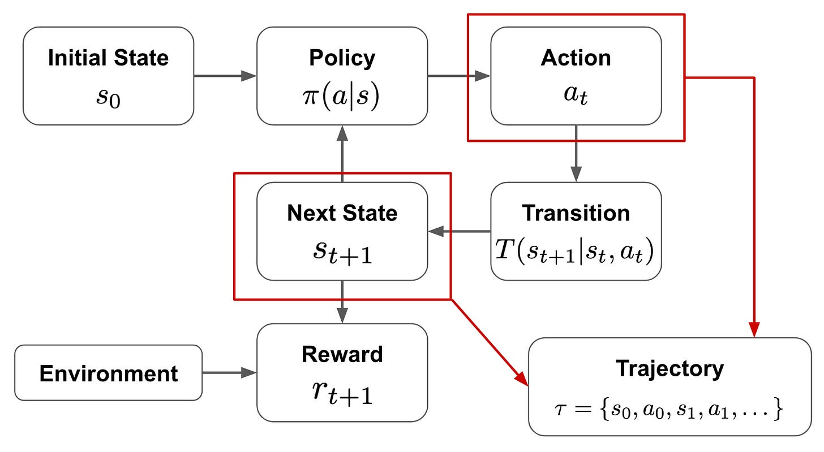
RLHF
The goal of RL is to train an agent that maximizes this return
States and actions have discrete values, while rewards are real numbers
Two type of functions:
Policy
Transition
Given an input, policy outputs a probability distribution over the possible list of actions
Agent executes the action
Transition consumes the action and current state to output the next state

Slide 30
Feature | PPO (Proximal Policy Optimization) | DPO (Direct Preference Optimization)
Optimization Type | Reinforcement Learning (RL) | Supervised-like Learning (Preference-based)
Loss Function | Policy gradient with clipping | Preference classification loss
Requires Rewards? | ✅ Yes, needs a reward function | ❌ No, learns directly from preferences
Training Complexity | More complex, needs environment interaction | Simpler, preference-based fine-tuning
Example Use Cases | Game AI, Robotics, LLM fine-tuning (RLHF) | LLM fine-tuning via human preferences

Slide 31
DISTIL BERT
DistilBERT (Distilled BERT) is a lighter and faster version of BERT, designed to retain 97% of BERT’s performance while being 60% faster and using 40% fewer parameters.
It achieves this by applying knowledge distillation—a technique where a smaller model (the student) learns from a larger, fully trained model (the teacher)
Knowledge distillation is a technique where a large, computationally expensive model (teacher model) transfers its knowledge to a smaller, more efficient model (student model).
The student mimics the teacher’s behavior rather than learning from scratch
Instead of training on hard labels (e.g., "cat" or "dog"), the student model learns from the probabilistic outputs of the teacher.
If BERT predicts "Finance" with 90% probability and "Economics" with 8%, DistilBERT will try to replicate this distribution instead of just the correct label

Slide 32
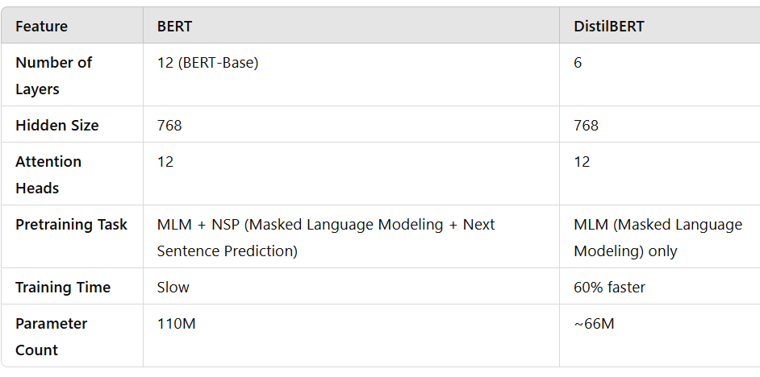
DISTIL BERT
The student’s output is trained to match the teacher’s predictions using Kullback-Leibler (KL) Divergence loss instead of just cross-entropy loss
Since the student follows the teacher’s distributions, it generalizes better
Instead of learning from one-hot labels, the student learns nuanced decision-making from the teacher’s soft probabilities

Slide 33
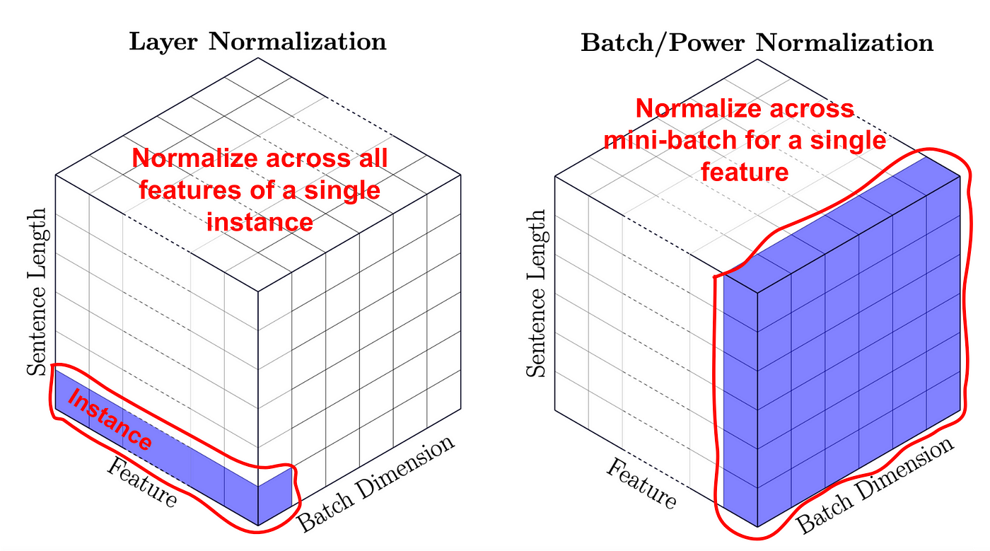
Layer Normalization
LayerNorm: Normalizes activations across the feature dimension (the embedding dimension) for each individual sequence.
This makes it independent of the batch size and well-suited for handling sequences of different lengths

Slide 34
XGBoost
Uses L1 and L2 Regularization
Uses second order approximation (hessians). Uses second order taylor expansion for loss calculation which uses both gradient and hessian
Grows tree to max depth and then prunes backward, removing branches that don’t contribute significantly to reduce the loss. Gamma threshold
Handles missing data
Speeds up training

